Slide 1

Protecting Clients
Capacity and Ethics
David Godfrey
Senior Attorney, ABA Commission on Law and Aging
Washington, DC David.Godfrey@Americanbar.org

Slide 2

What is Capacity
The ability to make an informed decision or choice

Slide 3


Capacity
Capacity is:
  A spectrum
Spectrum

Slide 4




Capacity Task Specific & Transient
Situational
Transient
Notes:
DG- I will explain this one. Capacity is situational, what are we asking the person to decide? I can drive the car, I can’t fly the Zeppelin – though I might be able to fly the Zeppelin with enough coaching. Capacity is not fixed, if is impacted by sleep, illness, medication, it can come and go, the determination of capacity at a given time, is really only assured for that time.

Slide 5


Capacity Can Be Impacted By
Illness
Pain
Lack of sleep
Medication
Substance Use / Abuse
Stress
Time of day
Greif
Depression
Mental health

Slide 6

Adults have a right to make bad choices,
As long as they understand

Slide 7

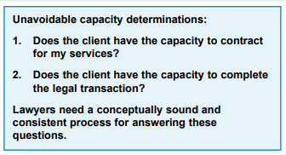
A Fundamental Question
That they Need Help,
you Could Help, and
they want you to Help them.

Slide 8
Specific legal standards
Testamentary Capacity:
  At the time executing a will, the individual must know the natural objects of their bounty, to understand the nature and extent of their property, and to connect these elements sufficiently to make a disposition of property according to a rational plan.
Whether the testator is of “sound mind” of is the terminology that is still commonly used.

Slide 9
Power of Attorney
Capacity to Execute a Power of Attorney:
  The standard of capacity for creating a power of attorney has traditionally been based on the capacity to contract. However, some courts have also held that the standard is similar to that for making a will.
  The document names an agent
  The agent can bind them to decision
  They can revoke the appointment
  The nature of the authority they are delegating

Slide 10
Contractual Capacity
Courts generally assess the party’s ability to understand the nature and effect of the act and the business being transacted.
If the act or business being transacted is highly complicated, a higher level of understanding may be needed to comprehend its nature and effect.

Slide 11
Capacity to Convey Real Property
To execute a deed, a grantor typically must be able to understand the nature and effect of the act at the time the conveyance is made.
In other words:
  Transferring rights in the real property to another.
  No longer having the right to use or occupy.
  Not being able to reclaim use or occupancy.

Slide 12
Capacity, if Not Stated
Understand essential legal elements
Understand options
Understands consequences of choice
Able to make a choice

Slide 13

Case Example: Edna and Bill
Edna and Bill have been married for 62 years. They arrive for your meeting and Edna does the talking, saying that they want to leave everything to each other, then when second one dies, in equal shares to their three children. Edna wants to be named as the agent in a power of attorney and as heath care surrogate for Bill. For her power of attorney and health care surrogate Edna wants to name their oldest son. You ask Bill what he wants, he says, “whatever Edna says will be fine.” You ask Bill the names of his children, and he responds, “ask Edna.” You ask him what bank their life savings is in, and he turns to Edna and says, “you know that don’t you?”

Slide 14

Poll #1: What are the Red Flags?
A: Edna’s speaking for both of them
B: Edna’s choice for her agents
C: Bill’s deferring to Edna
D: Bill’s inability to answer basic questions
E: All of the above

Slide 15

What Do The Model Rules Say About Capacity?

Slide 16
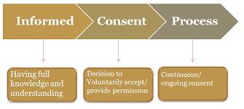

MRPC 1.0 Terminology
"Informed consent" denotes the agreement by a person to a proposed course of conduct after the lawyer has communicated adequate information and explanation about the material risks of and reasonably available alternatives to the proposed course of conduct.

Slide 17

Model Rules of Professional Conduct 1.4
(a) A lawyer shall:
(3) keep the client reasonably informed about the status of the matter;
(b) A lawyer shall explain a matter to the extent reasonably necessary to permit the client to make informed decisions regarding the representation.

Slide 18

MRPC 1.2: Scope Of Representation & Allocation Of Authority Between Client & Lawyer
(a) Subject to paragraphs (c) and (d), a lawyer shall abide by a client's decisions concerning the objectives of representation and, as required by Rule 1.4, shall consult with the client as to the means by which they are to be pursued. A lawyer may take such action on behalf of the client as is impliedly authorized to carry out the representation. A lawyer shall abide by a client's decision whether to settle a matter. In a criminal case, the lawyer shall abide by the client's decision, after consultation with the lawyer, as to a plea to be entered, whether to waive jury trial and whether the client will testify.

Slide 19


How do We Get To Capacity From That?
A client has capacity if we are able to communicate in a way that the client can understand, to the degree necessary for the client to give informed consent regarding the objectives (goals) of the representation.
If not, the client lacks capacity.

Slide 20

MRPC 1.14 A Client With Diminished Capacity
Client-Lawyer Relationship
(a) When a client's capacity to make adequately considered decisions in connection with a representation is diminished, whether because of minority, mental impairment or for some other reason, the lawyer shall, as far as reasonably possible, maintain a normal client-lawyer relationship with the client.

Slide 21

Tell Me More
MRPC 1.14 (b)
(b) When the lawyer reasonably believes that the client has diminished capacity, is at risk of substantial physical, financial or other harm unless action is taken and cannot adequately act in the client's own interest, the lawyer may take reasonably necessary protective action, including consulting with individuals or entities that have the ability to take action to protect the client and, in appropriate cases, seeking the appointment of a guardian ad litem, conservator or guardian.

Slide 22

MRPC 1.14 Comment 1
[1] The normal client-lawyer relationship is based on the assumption that the client, when properly advised and assisted, is capable of making decisions about important matters. When the client is a minor or suffers from a diminished mental capacity, however, maintaining the ordinary client-lawyer relationship may not be possible in all respects. In particular, a severely incapacitated person may have no power to make legally binding decisions. Nevertheless, a client with diminished capacity often has the ability to understand, deliberate upon, and reach conclusions about matters affecting the client's own well-being. For example, children as young as five or six years of age, and certainly those of ten or twelve, are regarded as having opinions that are entitled to weight in legal proceedings concerning their custody. So also, it is recognized that some persons of advanced age can be quite capable of handling routine financial matters while needing special legal protection concerning major transactions.

Slide 23

MRPC 1.14 Comments 2 – 3
[2] The fact that a client suffers a disability does not diminish the lawyer's obligation to treat the client with attention and respect. Even if the person has a legal representative, the lawyer should as far as possible accord the represented person the status of client, particularly in maintaining communication.
[3] The client may wish to have family members or other persons participate in discussions with the lawyer. When necessary to assist in the representation, the presence of such persons generally does not affect the applicability of the attorney-client evidentiary privilege. Nevertheless, the lawyer must keep the client's interests foremost and, except for protective action authorized under paragraph (b), must look to the client, and not family members, to make decisions on the client's behalf.

Slide 24

How Do We Assess Capacity?
We do it every time we communicate interactively
There Is No Simple Test,
Look To The Totality Of The Circumstances – The Clients Ability To Communicate And Give Informed Consent
When In Doubt, Seek Guidance Before Proceeding

Slide 25
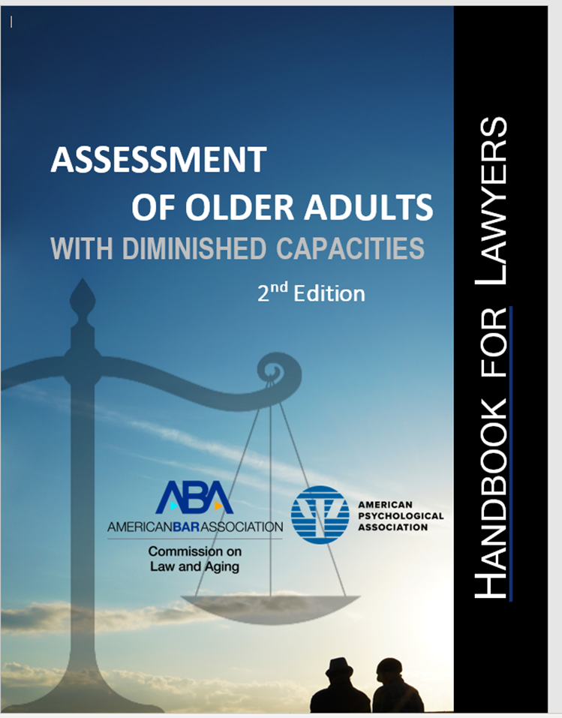
Now Available
https://www.americanbar.org/products/inv/book/411701219/

Slide 26
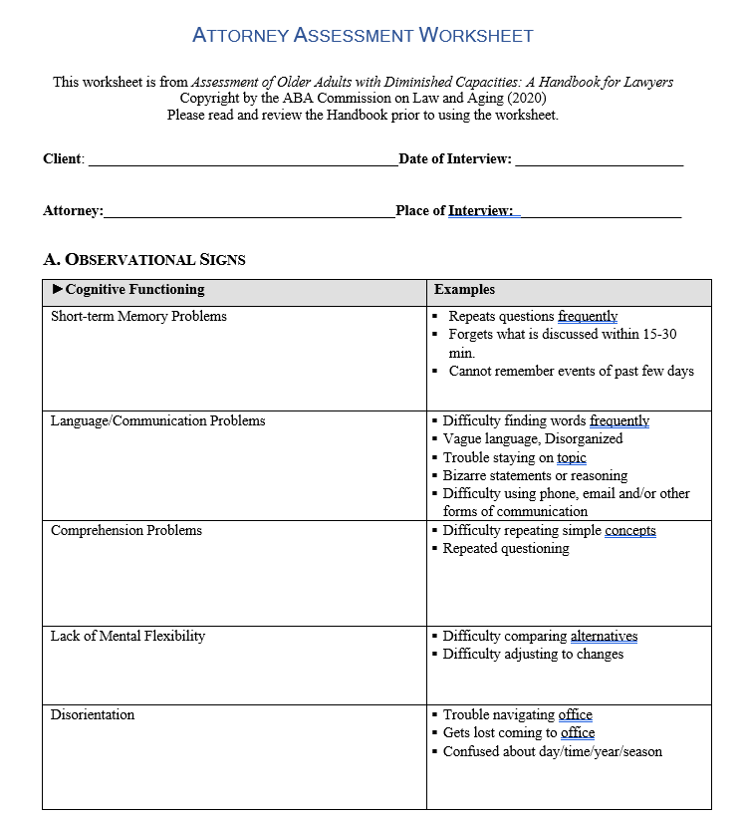

Slide 27
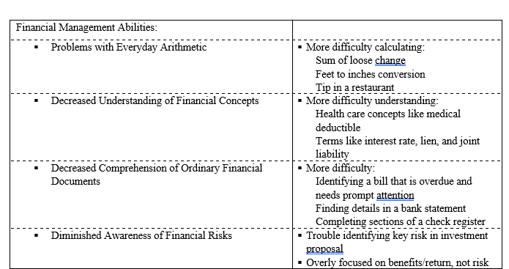


Slide 28

Uncomfortable Fact
Research shows that financial judgement peaks at age 52

Slide 29


Decline in Capacity
Credit Scores, on average start to decline 7 years before a person is diagnosed with Alzheimer’s
  Collections or judgements, credit utilization, timely payment
Unpaid bills are most common,
Unusual spending is less common

Slide 30
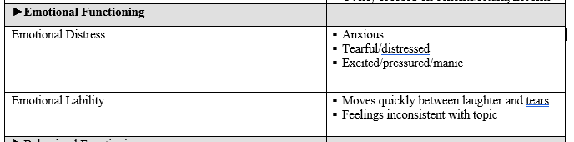

Slide 31
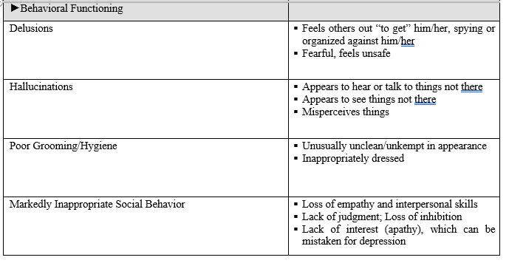

Slide 32


Slide 33
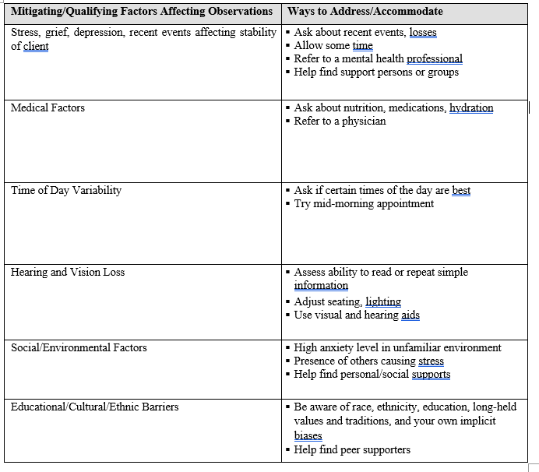

Slide 34
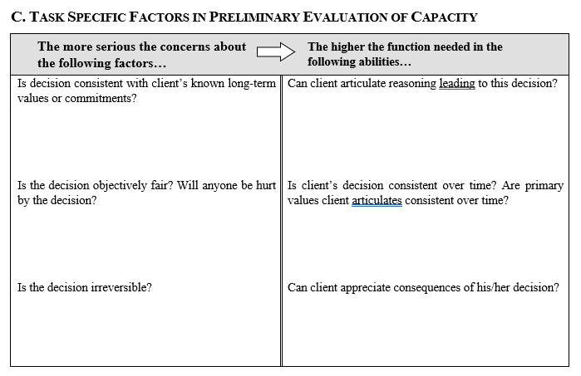

Slide 35
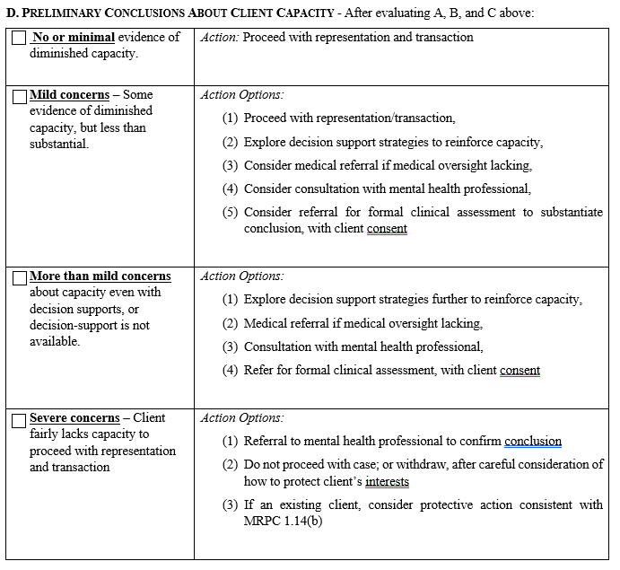

Slide 36

Use of power and control to
Exploit trust, dependency and fear
Substitution of one person’s will for the true desires of another
Purpose: gaining control

Slide 37
Screening Tool
California Undue Influence Screening Tool, available at: www.elderjusticecal.org
Undue Influence Means Excessive Persuasion That Causes Another Person To Act Or Refrain From Acting By Overcoming That Person's Free Will And Results In Inequity. In Determining Whether A Result Was Produced By Undue Influence, All Of The Following Shall Be Considered:
  The Vulnerability Of The Victim….
  The Influencer's Apparent Authority….
  The Actions Or Tactics Used By The Influencer….
  The Equity Of The Result….
  Cal. Welf. & Inst. Code § 15610.70 & Probate Code §86
Tool Provides A Checklist Of Indicators For Each Of The Four Factors.

Slide 38
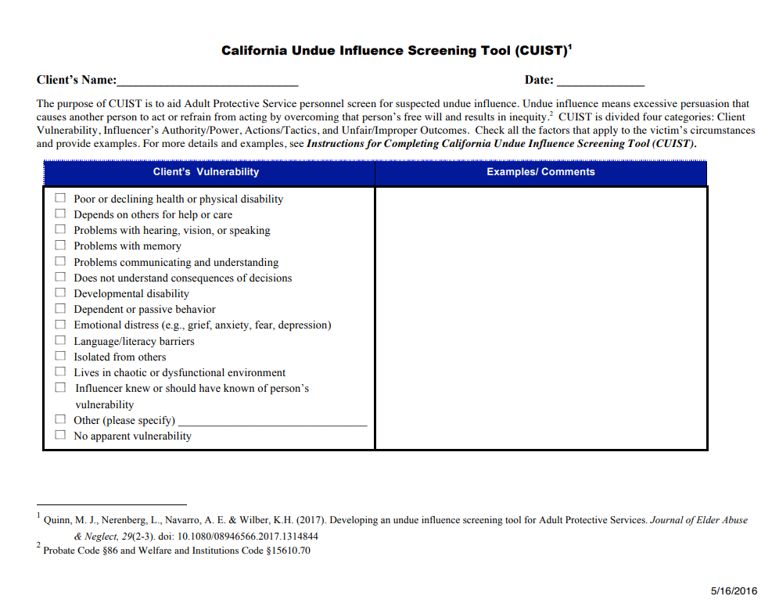

Slide 39
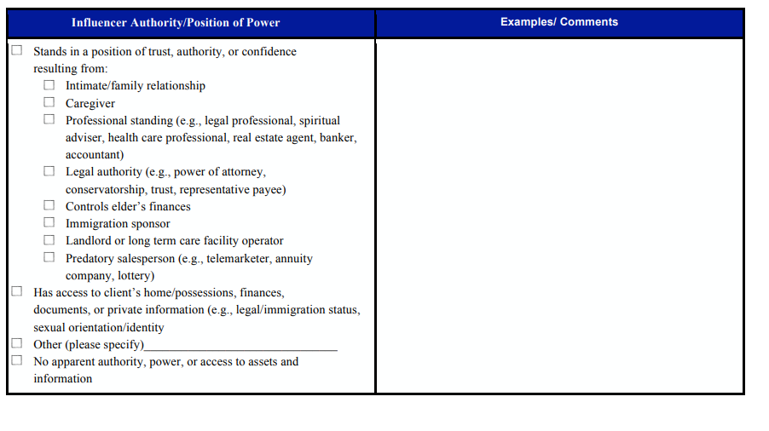

Slide 40
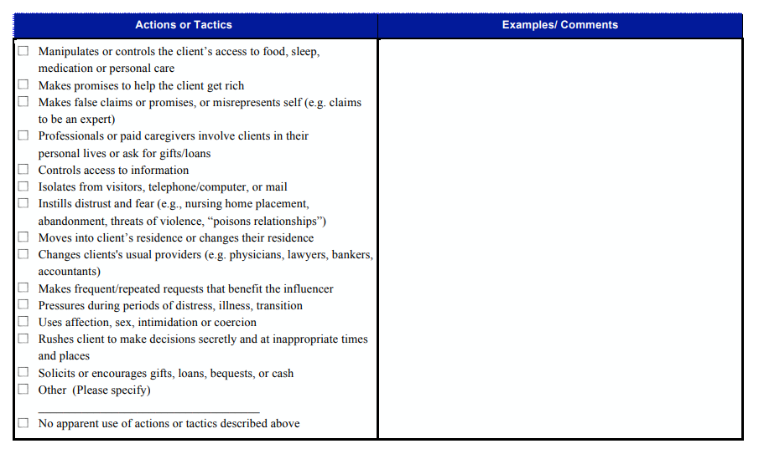

Slide 41
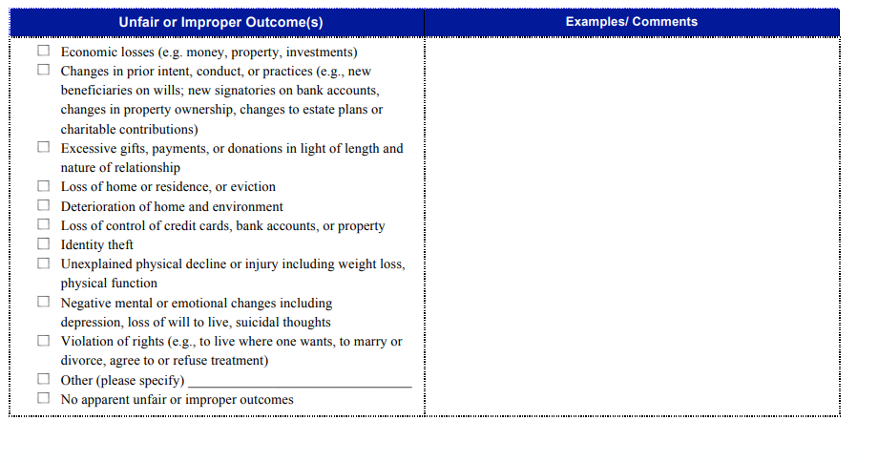

Slide 42
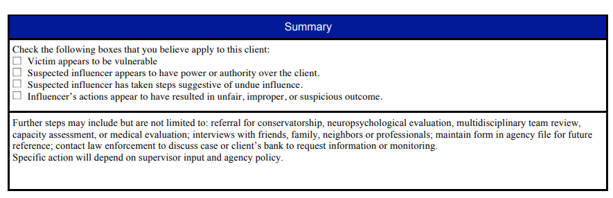

Slide 43

Declining Or Terminating Representation MRPC 1.16 (A)
(A) Except As Stated In Paragraph (C), A Lawyer Shall Not Represent A Client Or, Where Representation Has Commenced, Shall Withdraw From The Representation Of A Client If:
(1) The Representation Will Result In Violation Of The Rules Of Professional Conduct Or Other Law;

Slide 44

MRPC 1.16 (B)
(B) Except As Stated In Paragraph (C), A Lawyer May Withdraw From Representing A Client If:
(1) Withdrawal Can Be Accomplished Without Material Adverse Effect On The Interests Of The Client;
(2) The Client Persists In A Course Of Action Involving The Lawyer's Services That The Lawyer Reasonably Believes Is Criminal Or Fraudulent;
(3) The Client Has Used The Lawyer's Services To Perpetrate A Crime Or Fraud;

Slide 45

Unique Definitions
Financial exploitation is the unauthorized use or taking of the money or property of a vulnerable adult for the benefit of another person.
Lack of capacity – theft from a person who is unable to form informed consent
Undue influence is the exertion of influence, over a vulnerable adult, with the intent to override or change the choice or free will of the person, for the benefit of another person.
Fraud is a theft involving an intentional lie or misstatement of the fact, with the intent that the person will rely on it to the benefit of another person.

Slide 46
R=Required O= Optional | Vulnerability | Person in a position of power or influence | Intentional lie, or material misstatement of fact | Theft or use of money or property for the benefit of another
Financial Exploitation | R | O | O | R
Lack of Capacity | R Unable to form informed consent |  |  | R
Undue Influence | R Must have capacity | R | O | R
Fraud | O | O | R | R

Slide 47


Screening for Financial Exploitation
Anyone can do this
Asking friendly questions
Showing genuine interest in the person

Slide 48
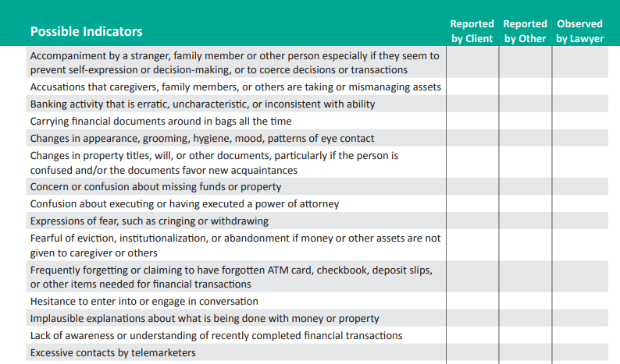
https://www.americanbar.org/content/dam/aba/administrative/law_aging/2020-eiffe-lawyers-checklist.pdf

Slide 49
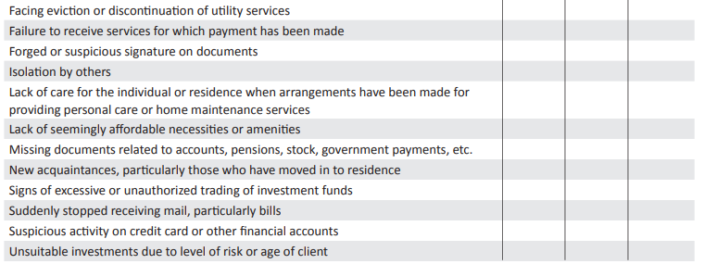

Slide 50
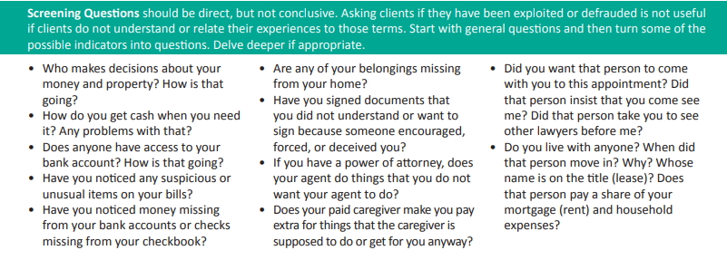

Slide 51


Thank You! David.Godfrey@Americanbar.org

